Slide 1
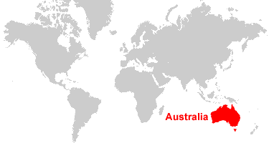
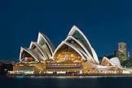
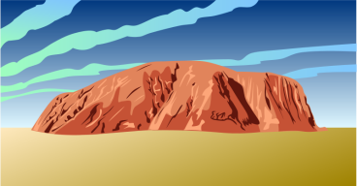
Australia

Slide 2
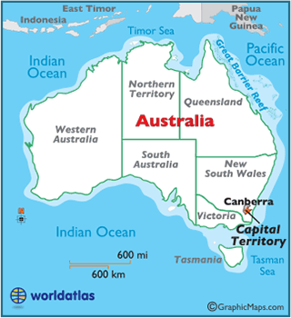
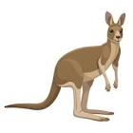

Slide 3
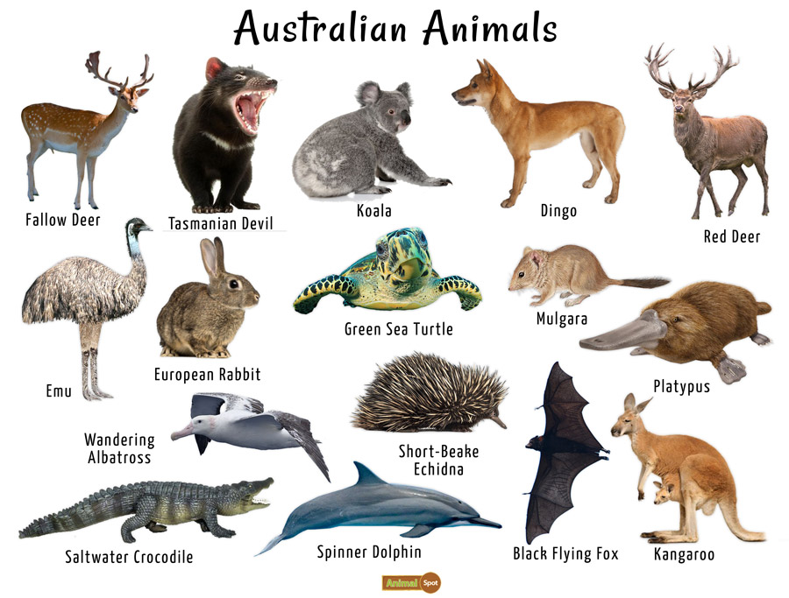

Slide 4
Link to 12 Best Cities in Australia

Slide 5
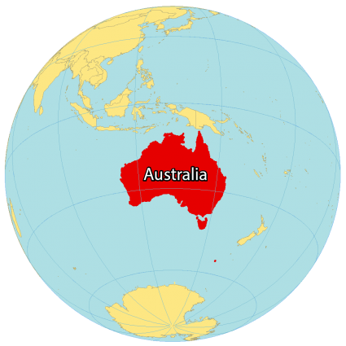
December 12-19
Economic Understandings
SS6E10,11,12

Slide 6
Economic Understandings
SS6E10 Analyze different economic systems.
c. Describe the economic system used in Australia.
SS6E11 Give examples of how voluntary trade benefits buyers and sellers in Australia.
a. Explain how specialization makes trade possible between countries.
SS6E12 Describe factors that influence economic growth and examine their presence or absence in Australia.
a. Evaluate how literacy rates affect the standard of living.
b. Explain the relationship between investment in human capital (education and training) and gross domestic product (GDP per capita).
c. Explain the relationship between investment in capital goods (factories, machinery, and technology) and gross domestic product (GDP per capita).
d. Describe the role of natural resources in a country’s economy.
e. Describe the role of entrepreneurship.

Slide 8
Monday, December 12
Standard: Economic Understandings
SS6E10 Analyze different economic systems.
Learning Target: I can describe the different economic systems in Australia.
Warm-up: Cloze Notes (Brain Wrinkles)
Work Session: Students will read Chapter 11 Section 4; Chapter Review; Students will prepare Study Guide Powerpoint for Australia Test; Students will work with partner on Australia Project
Closing: TOD
Reminders:

Slide 9
Australia’s established world reputation has long been that of a wealthy underpopulated country prone to natural disasters, its economy depending heavily on agriculture (“riding on the sheep’s back”) and foreign investment. This description was reasonably fair during the first century of European settlement, when wool exports reigned supreme. Wheat, beef, lamb, dairy produce, and a range of irrigated crops also became important, but the key significance of farming and grazing was not challenged. However, this image was shattered by the growth of manufacturing and services and especially by the spectacular developments in mineral exploitation after World War II.
The Australian economy is dominated by its service sector, which in 2017 comprised 62.7% of the GDP and employed 78.8% of the labour force.^{[6]} At the height of the mining boom in 2009–10, the total value-added of the mining industry was 8.4% of GDP.^{[37]} Despite the recent decline in the mining sector, the Australian economy had remained resilient and stable^{[38][39]} and did not experience a recession from 1991 until 2020.^{[40][41]}

Slide 10
Tuesday, December 13
Standard: Economic Understandings
SS6E10 Analyze different economic systems.
Learning Target: I can describe the different economic systems in Australia.
Warm-up: Cloze Notes (Brain Wrinkles)
Work Session: Students will read Chapter 11 Section 4; Chapter Review; Students will prepare Study Guide Powerpoint for Australia Test; Students will work with partner on Australia Project
Closing: Think-Pair-Share
Reminders:

Slide 11
Wednesday, December 14
Standard: Economic Understandings
SS6E11 Give examples of how voluntary trade benefits buyers and sellers in Australia.
a. Explain how specialization makes trade possible between countries.
Learning Target: I can explain how trade benefits buyers and sellers.
Warm-up: Cloze Notes (Brain Wrinkles)
Work Session: Students will read Chapter 11 Section 4; Chapter Review; Students will prepare Study Guide Powerpoint for Australia Test; Students will work with partner on Australia Project
Closing: Summarize key concepts
Reminders:

Slide 12
Thursday, December 15
Standard: Economic Understandings
SS6E12 Describe factors that influence economic growth and examine their presence or absence in Australia.
Learning Target: I can describe factors that influence economic growth.
Warm-up: Cloze Notes (Brain Wrinkles)
Work Session: Students will read Chapter 11 Section 4; Chapter Review; Students will prepare Study Guide Powerpoint of Australia Test; Students will work with partner on Australia Project
Closing: TOD
Reminders:

Slide 13
Friday, December 16
Standard:
Learning Target: GRIT Grade Recovery at TUTT
Warm-up:
Work Session: Students will work on missing work and assignments
Closing:
Reminders:

Slide 14
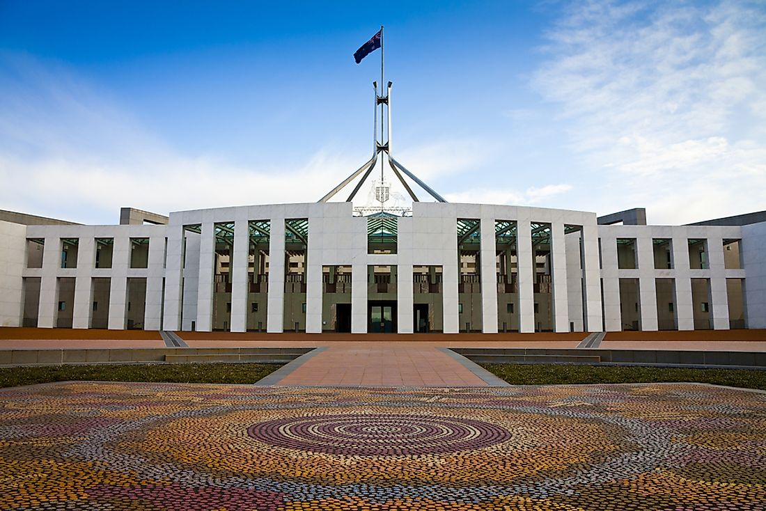
The Government of the Commonwealth of Australia is a federal democratic administrative authority of Australia. Australia’s system of government reflects both British and North American influences. Australia is governed by both the federal government and the state and territory governments. Queen Elizabeth II is Australia’s head of state under a constitutional monarchy. Australia is a member of the Commonwealth.

Slide 15
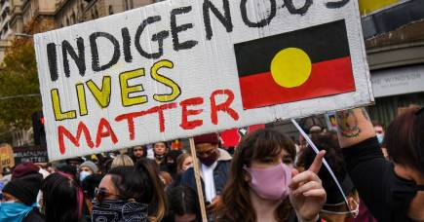
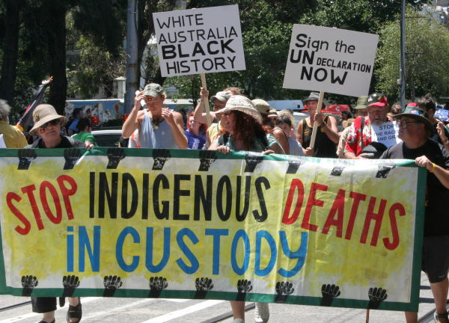
On Friday 3 April 2009 the Australian Government signed the Declaration on Rights for Indigenous Peoples at last. However aborigines have accused the Government of continued racism and hypocrisy regarding treatment of aborigines Australia-wide and particularly with the Northern Territory intervention

Slide 16
SS6H4
Explain the impact of English colonization on current Aboriginal basic rights, health, literacy, and language.

Slide 17
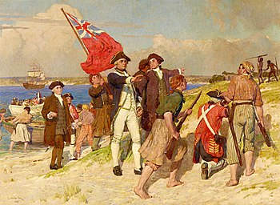

Slide 18
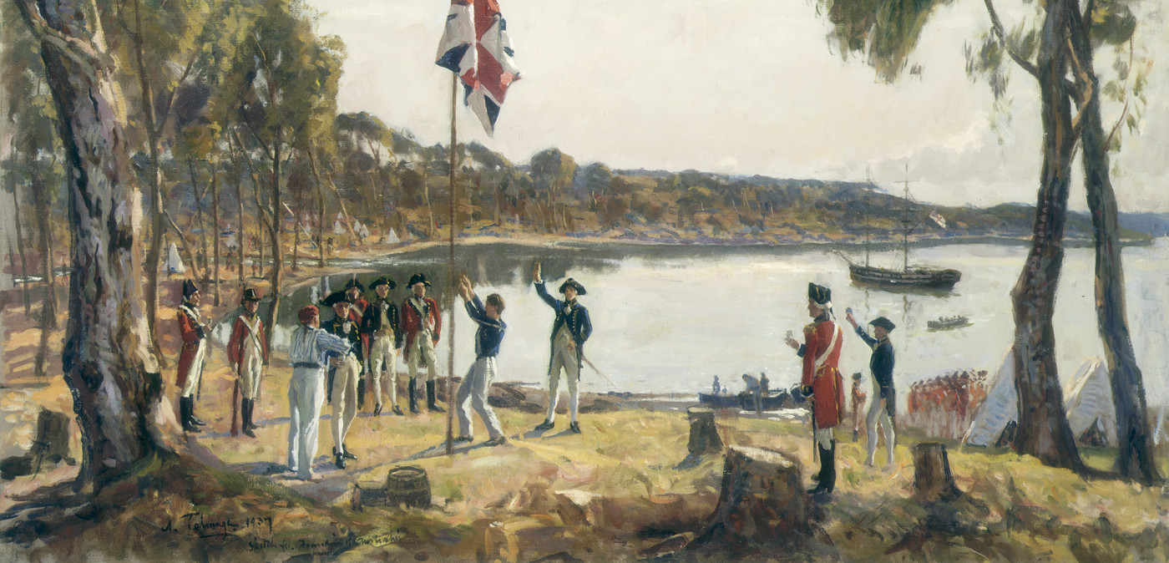

Slide 19
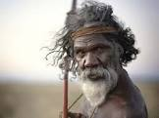
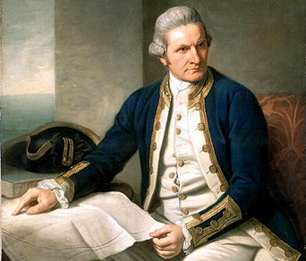
1788 – First Fleet and Convicts
The Dutch first sighted Australia in 1606 before Captain Cook colonized the land for Great Britain in 1770. The First Fleet of 11 boats arrived at Botany Bay in 1788 to establish New South Wales as a penal colony (receiving convicts until 1848). Convicts were later sent to the other states, with the exception of South Australia, which was established as a free colony in 1836.
Over 162,000 convicts were transported to Australia from Great Britain, the majority to New South Wales and Tasmania
First Nations Australian Origins
Indigenous Australians have lived in the nation for at least 50,000 years. This means they have the oldest living cultural history in the world. When the British arrived in 1788, as many as 250 different languages were spoken across the nation. Prior to the colonization of the British, there were between 300,000 and one million First Nations people living in Australia.

Slide 20
SS6G11 Locate selected features of Australia.
a. Locate on a world and regional political-physical map:
the Great Barrier Reef, Coral Sea, Uluru/Ayers Rock, Indian and Pacific Oceans, Great Dividing Range, and Great Victoria Desert.
SS6G12 Explain the impact of location, climate, distribution of natural resources, and population distribution on Australia.
a. Describe how Australia’s location, climate, and natural resources impact trade and affect where people live.

Slide 21
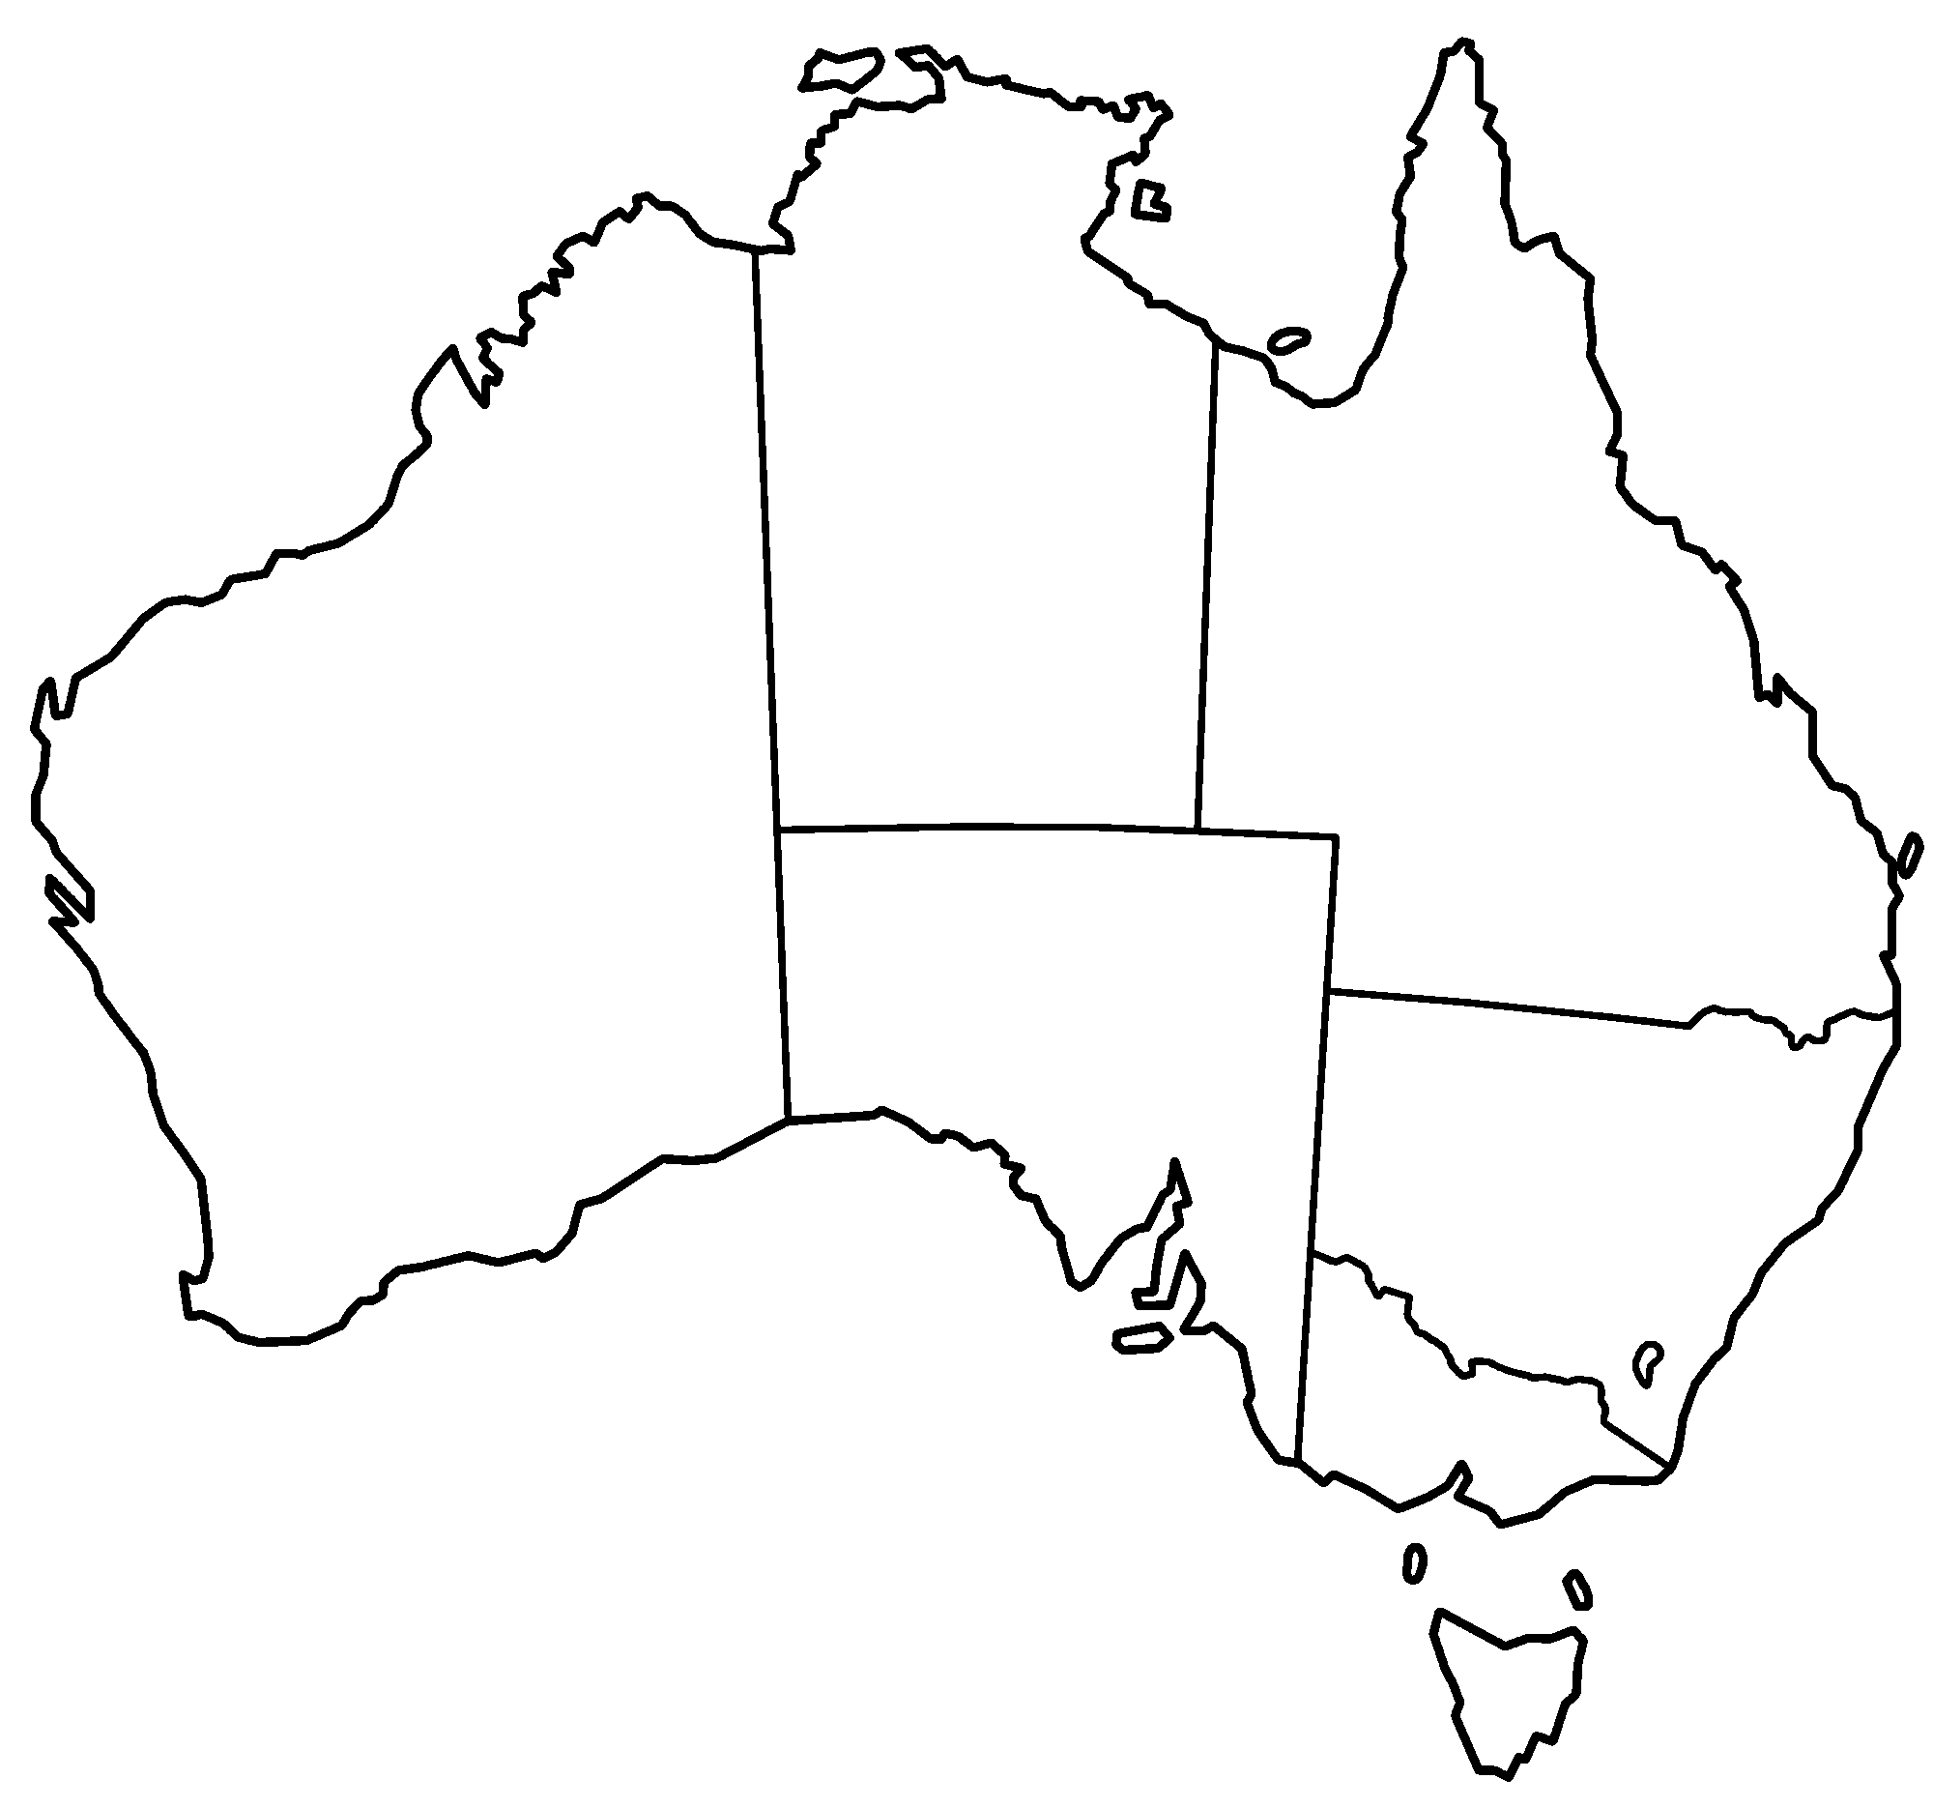
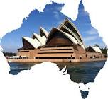
A
B
C
Northern Territory
D
Queensland
Western Australia
E
G
F
Southern Australia
New South Wales
B
Victoria
Indian Ocean (A)
Indian Ocean (B)
Coral Sea (C)
Great Barrier Reef (D)
Great Dividing Range (E)
Great Victoria Desert (F)
Uluru/Ayers Rock (G)
A
Tasmania
Land or water feature

Slide 22
Parents can use this map to quiz your child

Slide 23
A
B
C
Northern Territory
D
Queensland
Western Australia
E
G
F
Southern Australia
New South Wales
B
Victoria
A
Tasmania
Land or water feature

Slide 24
Only 58% of Indigenous Australians are registered to vote. We should be asking why
Video Link-
What you need to know before casting a ballot | Federal Election | 9 News Australia
4:55 / 23:32
How the Australian Government Works | AUSPOL EXPLAINED
Link to Video

Slide 25
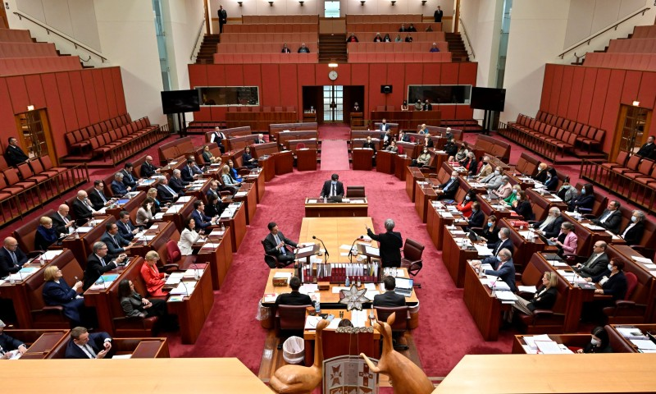
Read more about Australia Government
Link to Article
https://en.wikipedia.org/wiki/Australian_Government

Slide 26
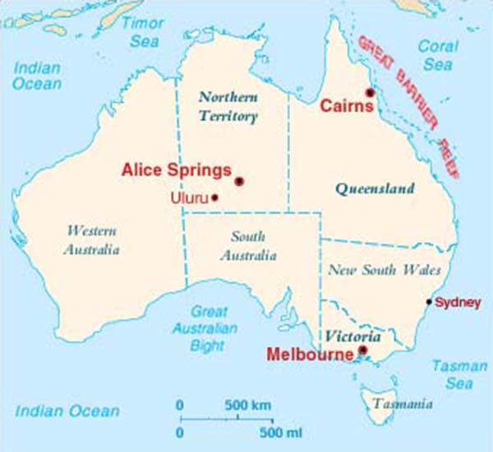

Slide 27
parliamentary system, democratic form of government in which the party (or a coalition of parties) with the greatest representation in the parliament(legislature) forms the government, its leader becoming prime minister orchancellor. Executive functions are exercised by members of the parliament appointed by the prime minister to thecabinet. The parties in the minority serve in opposition to the majority and have the duty to challenge it regularly. Prime ministers may be removed from power whenever they lose the confidence of a majority of the ruling party or of the parliament. The parliamentary system originated in Britain (see Parliament) and was adopted in several of its former colonies.

Slide 28
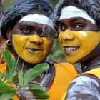
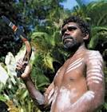
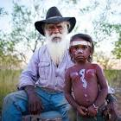
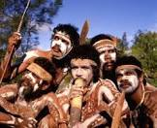

Slide 29
Australia’s first people—known as Aboriginal Australians—have lived on the continent for over 50,000 years. Today, there are 250 distinct language groups spread throughout Australia. Aboriginal Australians are split into two groups: Aboriginal peoples, who are related to those who already inhabited Australia when Britain began colonizing the island in 1788, and Torres Strait Islander peoples, who descend from residents of the Torres Strait Islands, a group of islands that is part of modern-day Queensland, Australia.

Slide 30
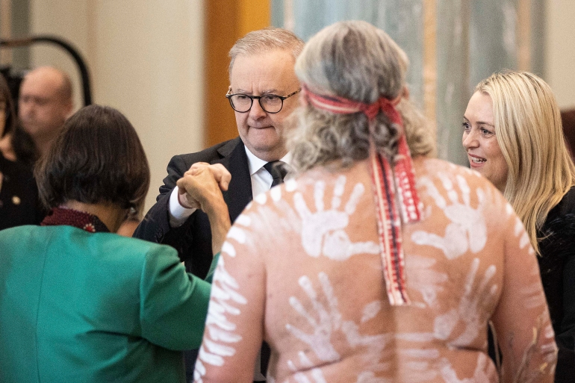
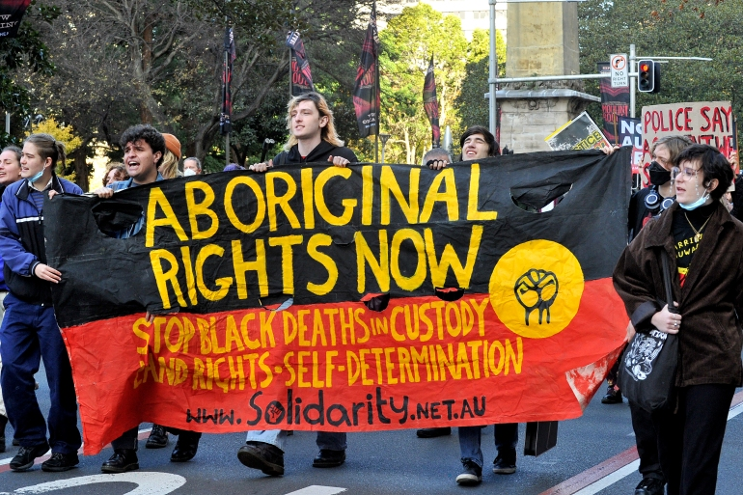

Slide 31
Current Ministry List
Link to Ministry List

Slide 32
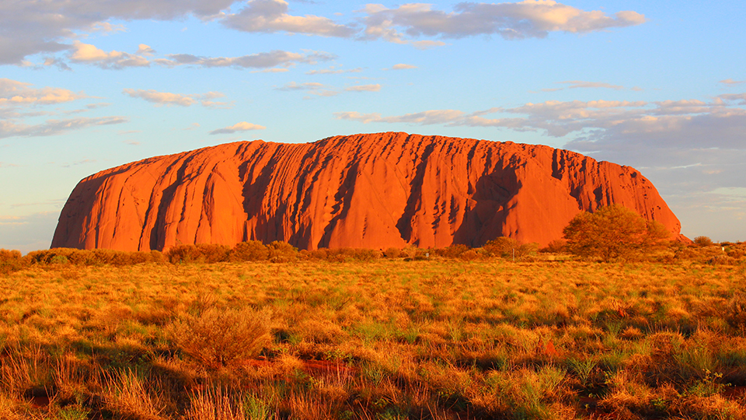
Uluru/Ayers Rock

Slide 33
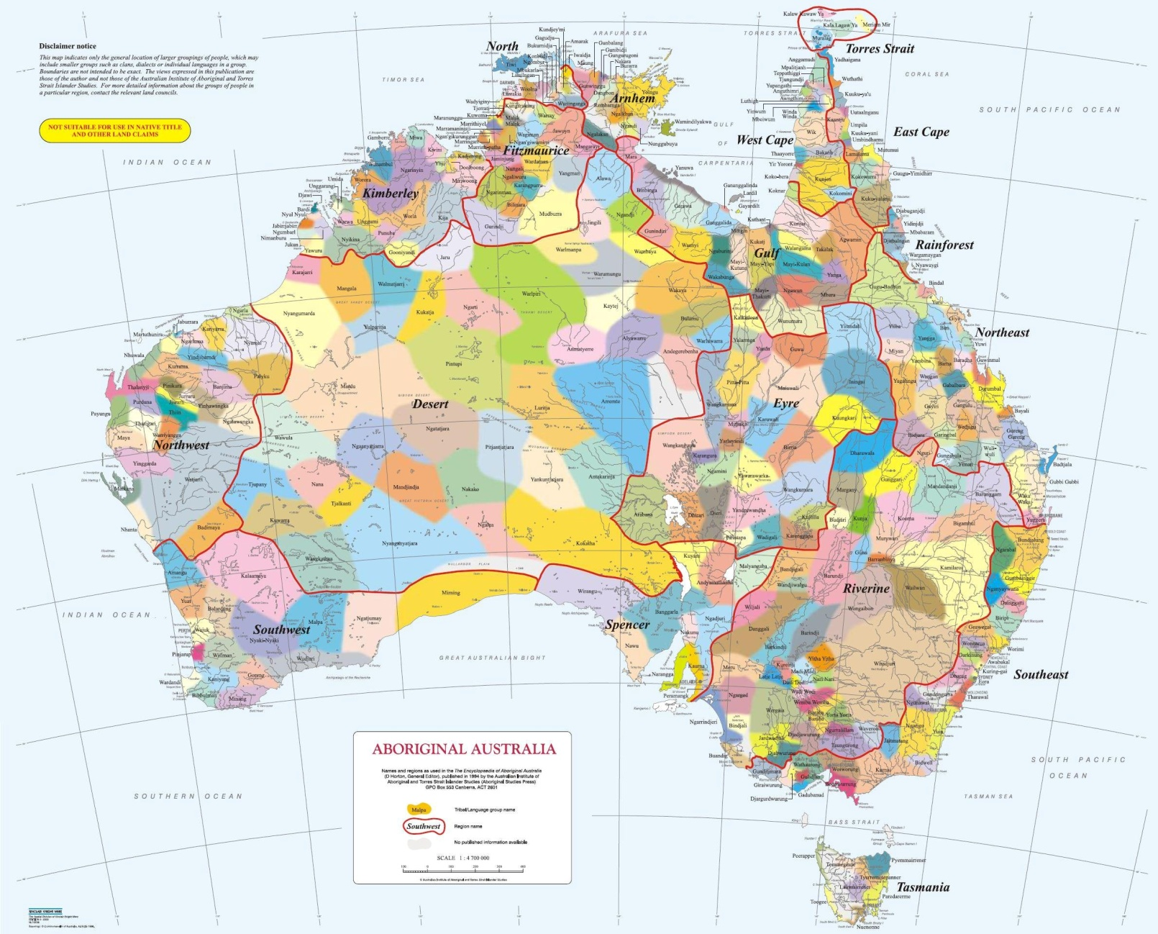
https://external-preview.redd.it/ckrO5dH3bwKW9yEGnPiiUtrqFIBPoEbPwwqOk4s2pcE.jpg?auto=webp&s=108b232de1e5696558ae5772fba3e813a4048068

Slide 34
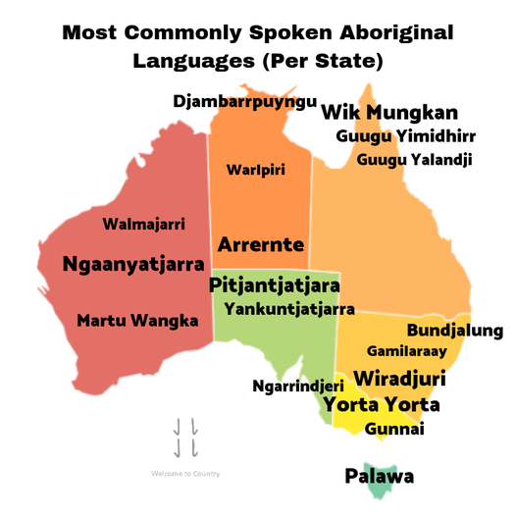

Slide 35
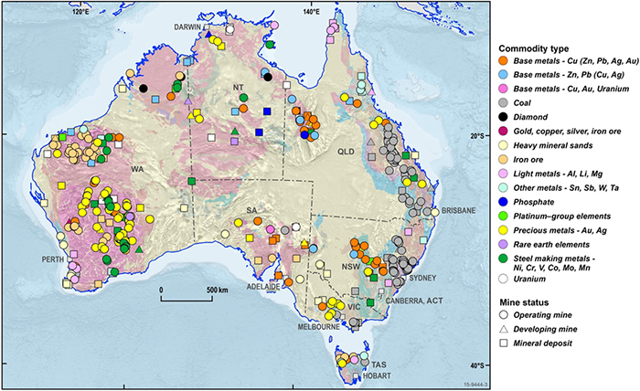
Australia is one of the world's leading producers of bauxite (aluminium ore), iron ore, lithium, gold, lead, diamond, rare earth elements, uranium, and zinc. Australia also has large mineral sand deposits of ilmenite, zircon and rutile.

Slide 36
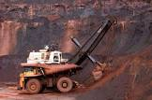
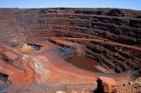
Western Australia Iron Ore (WAIO) is an integrated system of four processing hubs and five mines connected by more than 1,000 kilometres of rail infrastructure and port facilities in the Pilbara region of northern Western Australia

Slide 37
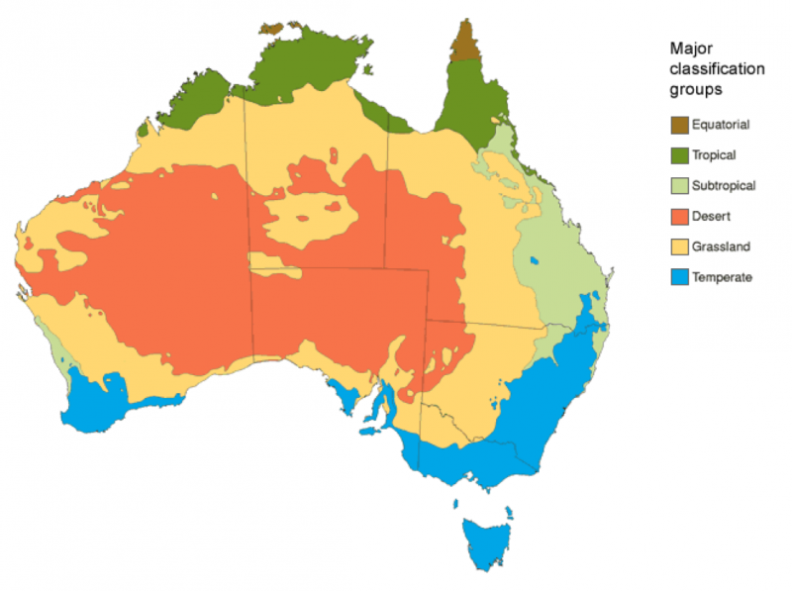
Climate

Slide 38
Historical Understandings
SS6H4 Explain the impact of English colonization on current Aboriginal basic rights, health, literacy, and language.
Geographic Understandings
SS6G11 Locate selected features of Australia.
a. Locate on a world and regional political-physical map: the Great Barrier Reef, Coral Sea, Uluru/Ayers Rock, Indian and Pacific Oceans, Great Dividing Range, and Great Victoria Desert.
SS6G12 Explain the impact of location, climate, distribution of natural resources, and population distribution on Australia.
a. Describe how Australia’s location, climate, and natural resources impact trade and affect where people live.

Slide 39
Australia
Historical Understandings
SS6H4 Explain the impact of English colonization on current Aboriginal basic rights, health, literacy, and language.
Geographic Understandings
SS6G11 Locate selected features of Australia.
a. Locate on a world and regional political-physical map: the Great Barrier Reef, Coral Sea, Uluru/Ayers Rock, Indian and Pacific Oceans, Great Dividing Range, and Great Victoria Desert.
SS6G12 Explain the impact of location, climate, distribution of natural resources, and population distribution on Australia.
a. Describe how Australia’s location, climate, and natural resources impact trade and affect where people live.
Government/Civic Understandings
SS6CG4 Explain forms of citizen participation in government.
a. Explain citizen participation in democratic governments [i.e. the role of citizens in choosing the leaders of Australia (parliamentary democracy)].

Slide 40
Economic Understandings
SS6E10 Analyze different economic systems.
a. Compare how traditional, command, and market economies answer the economic questions of 1-what to produce, 2-how to produce, and 3-for whom to produce.
b. Explain that countries have a mixed economic system located on a continuum between pure market and pure command.
c. Describe the economic system used in Australia.
SS6E11 Give examples of how voluntary trade benefits buyers and sellers in Australia.
a. Explain how specialization makes trade possible between countries.
b. Compare and contrast different types of trade barriers, such as tariffs, quotas, and embargoes.
c. Explain why international trade requires a system for exchanging currency between nations.
SS6E12 Describe factors that influence economic growth and examine their presence or absence in Australia.
a. Evaluate how literacy rates affect the standard of living.
b. Explain the relationship between investment in human capital (education and training) and gross domestic product (GDP per capita).
c. Explain the relationship between investment in capital goods (factories, machinery, and technology) and gross domestic product (GDP per capita).
d. Describe the role of natural resources in a country’s economy.
e. Describe the role of entrepreneurship.
SS6E13 Understand that a basic principle of effective personal money management is to live within one’s income.
a. Understand that income is received from work and is limited.
b. Understand that a budget is a tool to plan the spending and saving of income.
c. Understand the reasons and benefits of saving.
d. Understand the uses and costs of credit.

